Slide 1

Harippriya Sivapatham IAM Brown Bag Session – July 2016

Slide 2
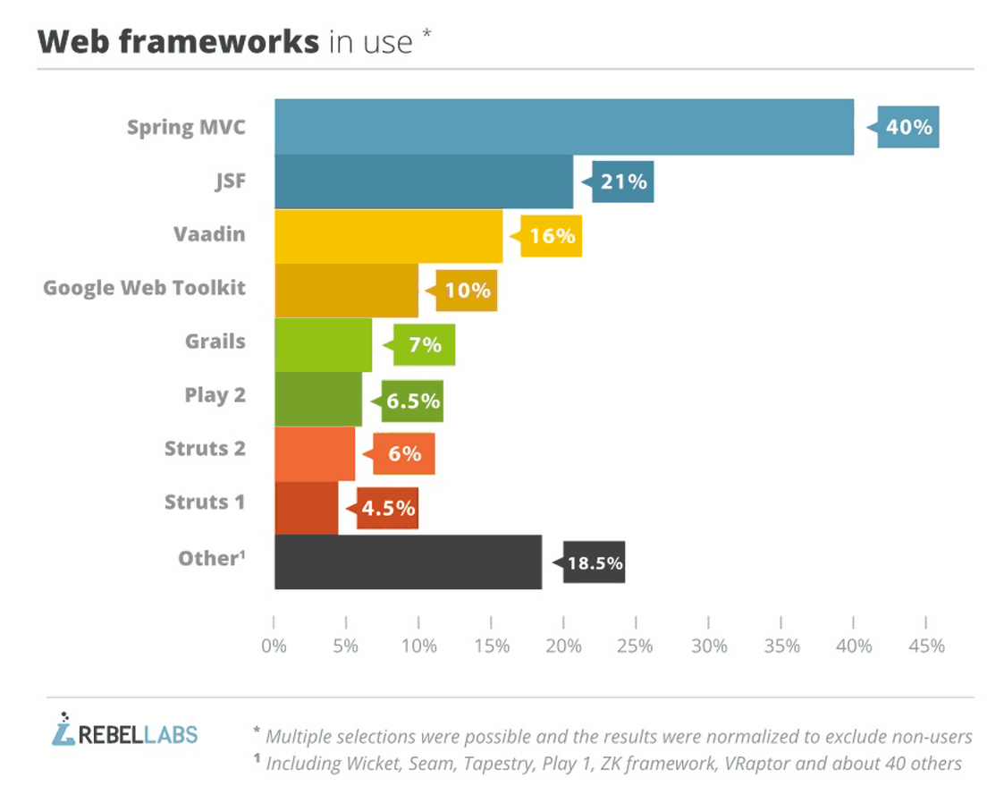
Why Spring?
#1 Java framework
Has 20+ add on projects to solve all enterprise application needs.

Slide 3


What is Spring?
Provides implementation of the common functionality.
Web App
R
E
S
T
Business Logic
DB
Tomcat
Elastic
Search
UI
Create a connection to Elastic Search
Create a query and get results.
Close connection.
Manage connections in a pool.
Return the results.
Replace with a single call to Spring Data

Slide 4
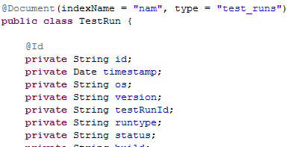
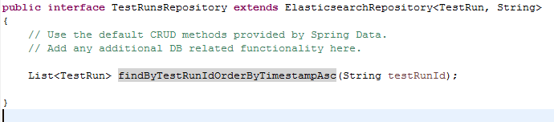
Spring Data Example
1. Create Data bean
Index (database): nam
Type (table): test_runs
Id
Timestamp
Status, etc
Read from Elastic Search’s TestRun table
2. Spring Data code to read from Elastic Search
Default Methods:
findAll()
findOne(id)
save()
delete()
count()
exists()

Slide 5
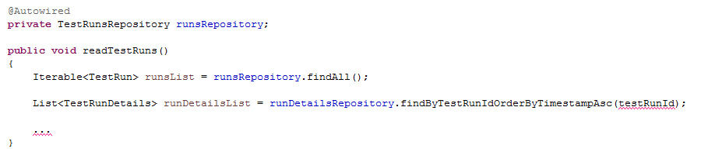
Spring Data Example (Continued)
Code to read the data:

Slide 6
Benefits of Spring
Handles the infrastructure so you can focus on your application.
Standardizes handling of the plumbing code.
Reduces code and speeds up development.
Helps develop generic independent applications.
Single framework for all layers of the application.
And more...

Slide 7

Spring Projects
UI
Spring
MVC
Spring
REST
Enterprise App
R
E
S
T
DB
Spring JDBC
RDBMS
Tomcat Webserver
Spring Data
NoSQL
Spring
Mobile
Spring Boot
Spring Security
Spring LDAP
LDAP
Spring Cloud, Spring Social, Spring Batch, Spring Integration, etc

Slide 8
Key Terms
Dependency Injection
@Autowired
Spring AOP - Aspect Oriented Programming
Separation of “cross cutting” concerns
Modularize functionality that is used across – Logging, Auditing, etc.

Slide 9
Getting Started
Go to Spring Initializr - https://start.spring.io/
Select projects you want and build an application.
Import into eclipse and start coding!

